Slide 1
Strong vs. Weak Entities, and Identifying Relationships
Strong entities
  exist independently of other types of entities
  has its own unique identifier
  identifier underlined with single-line
Weak entity
  dependent on a strong entity (identifying owner)…cannot exist on its
own
  does not have a unique identifier (only a partial identifier)
  Partial identifier underlined with double-line
  Entity box has double line
Identifying relationship
  links strong entities to weak entities

Slide 2
SUMMARY OF ER-DIAGRAM NOTATION FOR ER SCHEMAS
Symbol
Meaning
ENTITY TYPE
WEAK ENTITY TYPE
RELATIONSHIP TYPE
IDENTIFYING RELATIONSHIP TYPE ATTRIBUTE
KEY ATTRIBUTE MULTIVALUED ATTRIBUTE COMPOSITE ATTRIBUTE DERIVED ATTRIBUTE

Slide 3
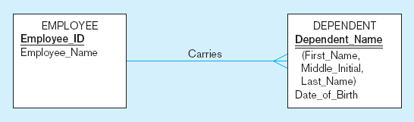
Identifying relationship
Strong entity
Weak entity
30

Slide 4
Associative Entities
An entity–has attributes
A relationship–links entities together
When should a relationship with attributes instead be an
associative entity?
  All relationships for the associative entity should be many
  The associative entity could have meaning independent of the other entities
  Ternary relationships should be converted to associative entities

Slide 5
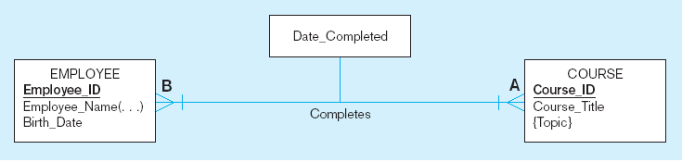
Figure 3-11a A binary relationship with an attribute
Here, the date completed attribute pertains specifically to the employee’s completion of a course…it is an attribute of the relationship

Slide 6
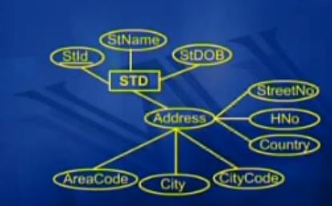
Composite Attributes
)

Slide 7
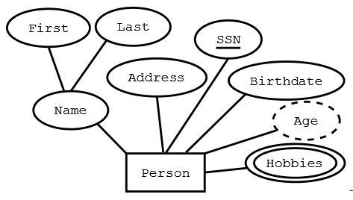
Mapping a multi-valued attribute

Slide 8
Optional Many to Mandatory One
EMP
PROJ

Slide 9
Optional Many to Mandatory One
EMP
PROJ
EMP(empId, empName, projId)

Slide 10
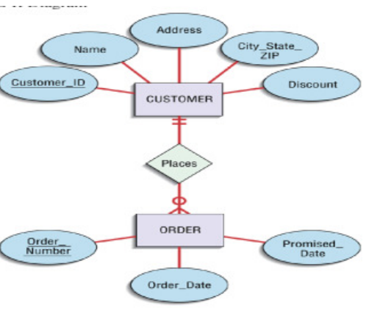
Mandatory One to Optional Many

Slide 11
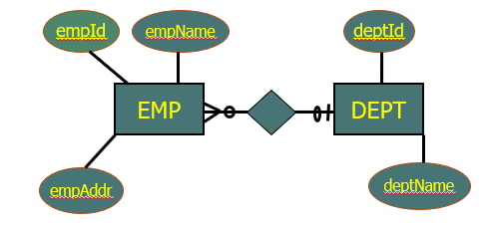
Optional Many to Optional One
EMP(empId, empName, empAddr, deptID)
DEPT(deptId, deptName)

Slide 12
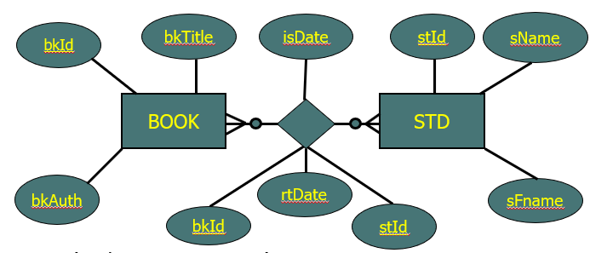
Many to Many Relationship

Slide 13
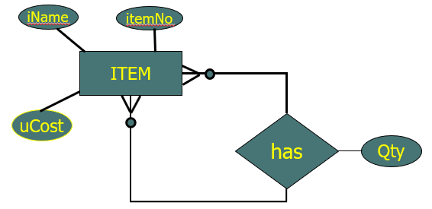
Unary Example

Slide 14
Creating an ERD from the Investigated Facts
Identify all the entities.
Identify all the relationships.
Identify cardinality and multiplicities (min max).

Slide 15
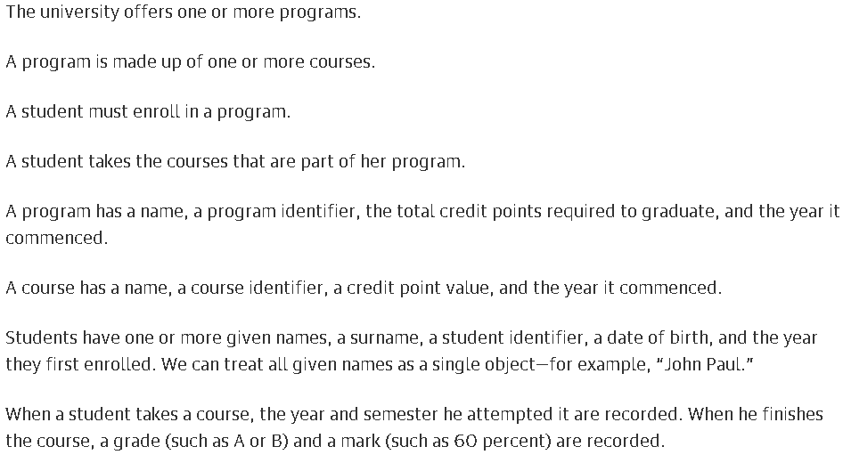
CASE STUDY 1

Slide 16
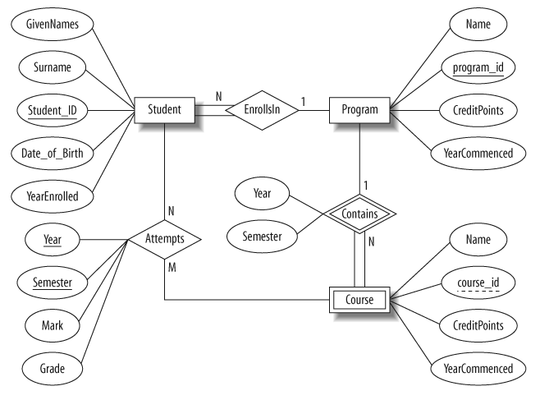
E-R Model

Slide 17
CASE STUDY 2
Movies are identified by their title and year of release.
They have length in minutes. They have a studio that produces the movie and are classified under one or more genres.
Each movie also has zero or more quotable quotes, which are spoken by a particular actor acting in the movie.
Movies are directed by one or more directors and have one or more actors acting in them.
Actors are identified by their names and date of birth and act in one or more movies. Each actor has a role in the movie.
Directors are also identified by their names and date of birth and direct one or more movies. It is possible for a director to act in movie (not necessarily in a movie they direct).
Studios are identified by their names and have an address. They produce one or more movies.

Slide 18
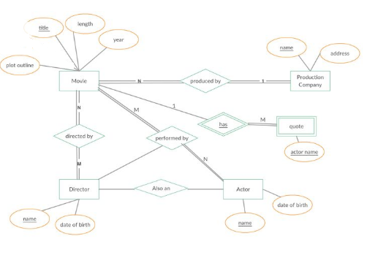
E-R Model

Slide 19
CASE STUDY 3
The mail order company has employee identified by a unique employee number. Their first name and name, and a zip code where they are located.
The customers of the company are identified by a unique customer number, their first and last name , and a zip code where they are located.
Order placed by customers are taken by employee and are given a unique order number , Each order may contain certain quantities of one or more parts and their received date as well as a shipped date is recorded

Slide 20
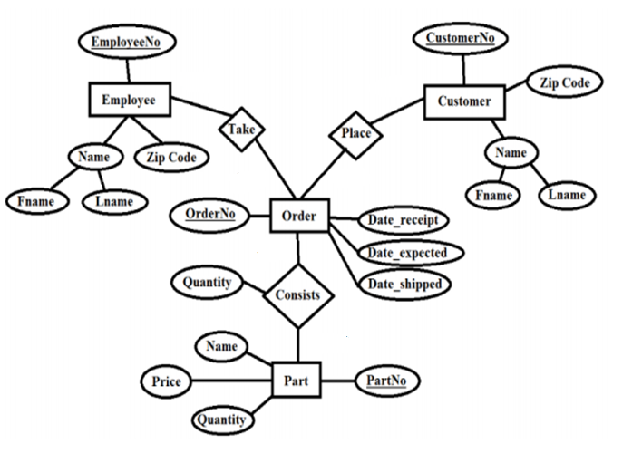
E-R Model

Slide 21
